Slide 1
Multiple Sequence Alignment Using Tabu Search
Tariq Riaz, Yi Wang, Kuo-Bin Li
In Proc. Second Asia-Pacific Bioinformatics Conference (APBC2004), Dunedin, New Zealand. CRPIT, 29. Chen, Y.-P. P., Ed. ACS. 223-232
Date : Mar. 15, 2005

Slide 2
Abstract
Tabu search is a meta-heuristic approach that is found to be useful in solving combinatorial optimization problems. We implement the adaptive memory features of tabu search to align multiple sequences. Adaptive memory helps the search process to avoid local optima and explores the solution space economically and effectively without getting trapped into cycles. The algorithm is further enhanced by introducing extended tabu search features such as intensification and diversification. It intensifies by bringing the search process to poorly aligned regions of an elite solution, and softly diversifies by moving from one poorly aligned region to another.

Slide 3
The neighborhoods of a solution are generated stochastically and a consistency-based objective function is employed to measure its quality. The algorithm is tested with the datasets from BAliBASE benchmarking database. We have observed through experiments that for datasets comprising orphan sequences, divergent families and long internal insertions, tabu search generates better alignment as compared to other methods studied in this paper.

Slide 4
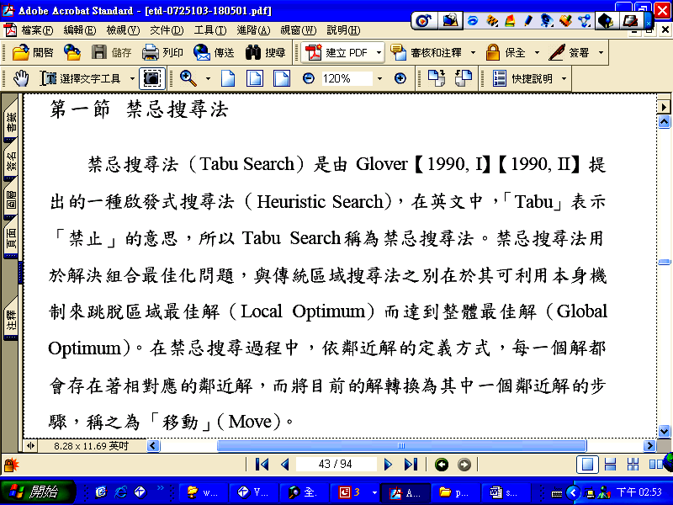
Tabu Search

Slide 5
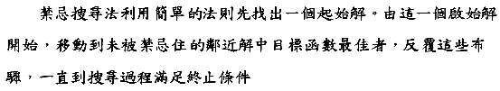
可分為短期記憶與長期記憶
短期記憶:
tabu list紀錄前幾次MOVE,避免重複相同路徑,形成cycle
長期記憶:
使用Intensification and Diversification 將搜尋帶入新的
region以求得更佳的解
Aspiration criteria

Slide 6
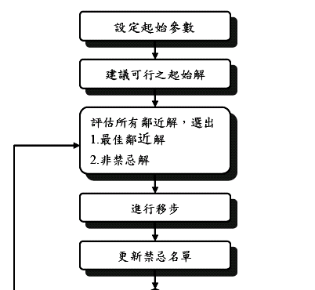
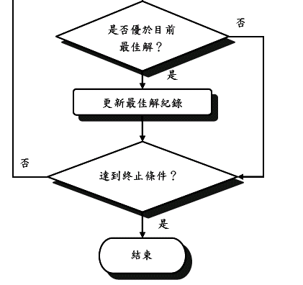

Slide 7
終止搜尋條件:
1.達到預設最大迭代次數後停止
2.目標函數在一定迭次內未改善終止
3.達到預設目標值即可停止

Slide 8
Initial solution
Unaligned initial solution:
the initial solution is formed by inserting fixed number of gaps into the sequences at regular intervals
Aligned initial solution:
Aligned initial solution is generated by computing the progressive alignment using an algorithm similar to the one proposed by Feng and Doolittle (Feng and Doolittle 1987).

Slide 9
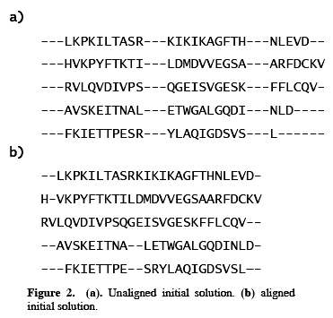

Slide 10
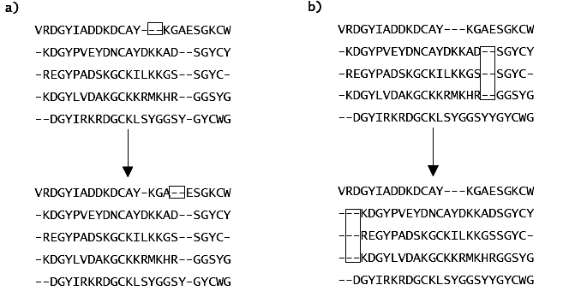
Move strategies
(a)Single sequence moves
(b)Block moves

Slide 11
The tabu search algorithm for multiple sequence alignment
Initialization: Generate initial solution Si.
Set the current solution Sc, and the elite
solution Se to Si.
Initialize tabu list TL to 0.
Initialize candidate move list ML to 0.
Set the tabu tenure to an arbitrary number.
Define aspiration criteria.
Generation: Generate single sequence and block moves
on solution Sc and add to candidate move list
ML
Evaluation: Evaluate COFFEE objective function for each
move in ML.

Slide 12
The tabu search algorithm for multiple sequence alignment
Selection:
Select the best move from ML.
if the selected move is not in TL, apply the move;
else if the selected move is in TL and aspiration criteria is
met,apply the move;
else remove the selected move from ML and go to Selection.
Update the tabu list.
Establish and update the tabu tenure.
Update the long-term memory for elite solution Se with
the best solution found so far.
Repeat the steps Generation, Evaluation and Selection until solution Sc stabilizes.

Slide 13
The tabu search algorithm for multiple sequence alignment
Intensification and Diversification:
Operate on solution Se to identify all the poorly
aligned regions.
Diversify from one poorly aligned region to
another and repeat the steps Generation,
Evaluation and Selection on each poorly aligned
region until the region stabilizes.
Repeat Intensification and Diversification until
the solution Se stabilizes.
End: Se holds the final solution.

Slide 14
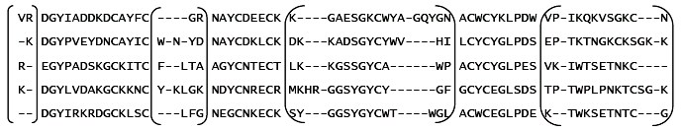

Slide 15
Conclusions
There is still vast room for improvement in the tabu search software.
Objective function (OF) is one of the areas that can be improved upon.
The parameters like tabu list size, tabu tenure, termination criteria, and neighborhood size can have a direct influence on the quality of the final alignment.

